Slide 1
University Model Implementation
Kunjan Gala (001553294)
Parth Joshi (001519059)
Sneha Swaroop (001572060)

Slide 2

Introduction
With abundant of courses provided by universities, it becomes daunting for some students to choose the relevant subjects which can help them in their career growth as well as align with their interests, while other students find themselves adrift to the current industry requirements. To minimize this problem for students, we have developed an application with a ranking system, which can help students to find out the courses that are best suited with the current industry requirements.

Slide 3
Problem Solution & Key Feature
Our objective is to deliver a system where university can find out the best courses by the analysis of alumni’s portfolio who have been in the job market for over 5 years. One key feature of our application is that alumni's can provide their feedback subjects they believe helped them frame their career.

Slide 4
Contd..
With the help of our application, students can track down the best courses on the basis of :
Courses suggested by alumni having high salaries.
Courses suggested by alumni who received maximum number of promotions within 5 years.
Courses suggested by students working in top tier companies.

Slide 5
Contd..
We also have a feature to find out percentage of students:
Having salary more than $120,000.
Who got two or more promotions in last 5 years.
Who have GPA more than 3.5
Employed in top 5 companies

Slide 6
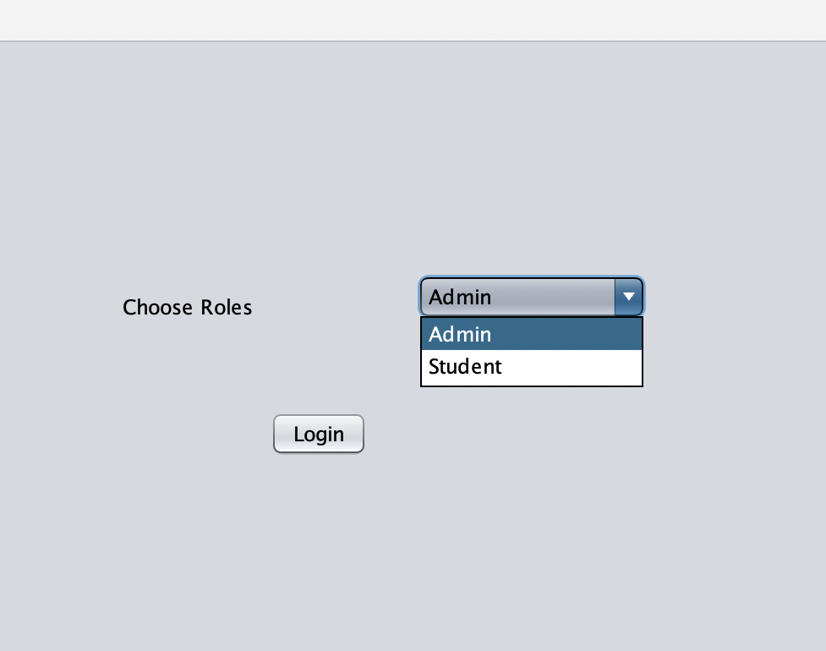
Design Model
Our application allows logins for :
Administrator
Students.

Slide 7
Administrator Login – Student’s Graduation Information
Administrator can view the information of all the students who are and have been part of the university. This information includes:
Student’s ID
Student’s Name
Courses opted by student
Total GPA

Slide 8

Admin Login - Student’s Employment Information
Administrator can view current employment information of each student which has been updated by students. This includes:
Current employer
Designation
Current salary

Slide 9
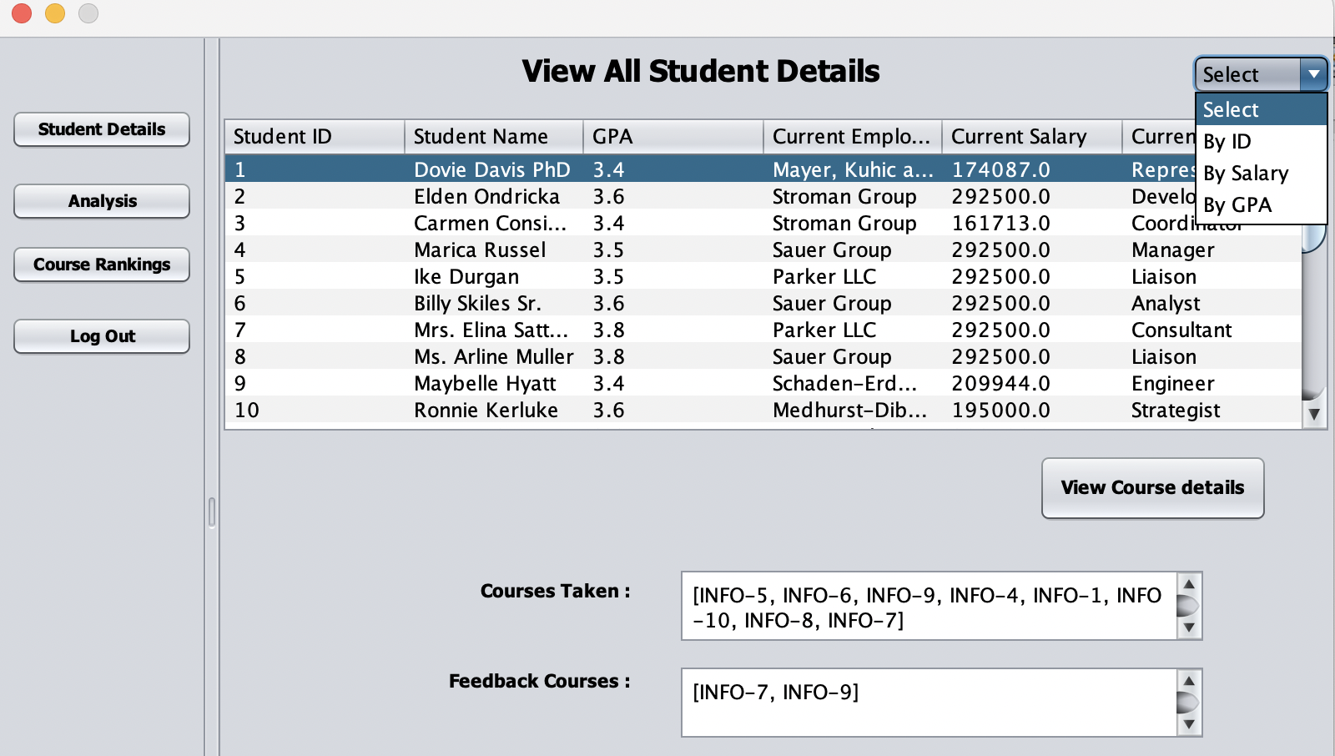
We have added a functionality where admin can analyze student data based on student’s:
GPA
Salary

Slide 10
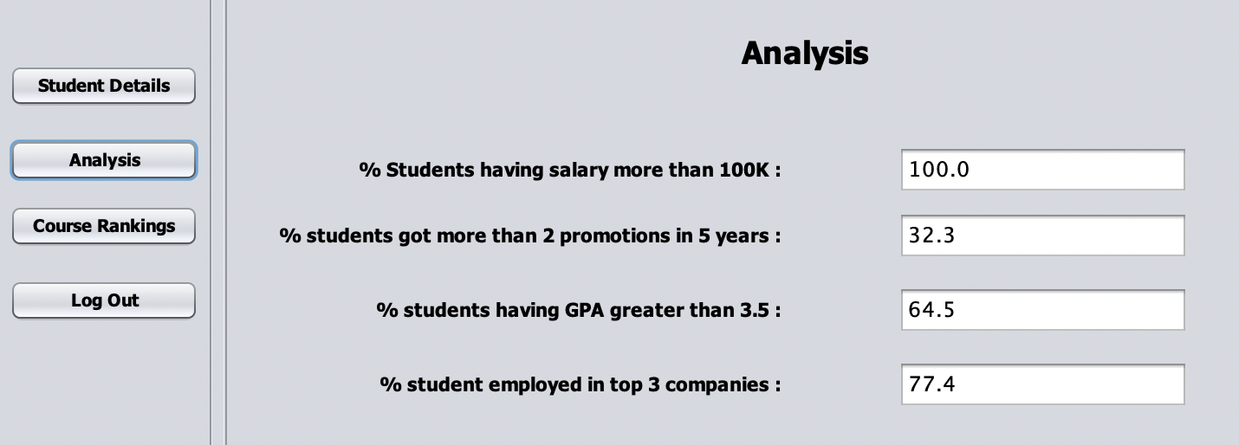
Analysis Dashboard

Slide 11
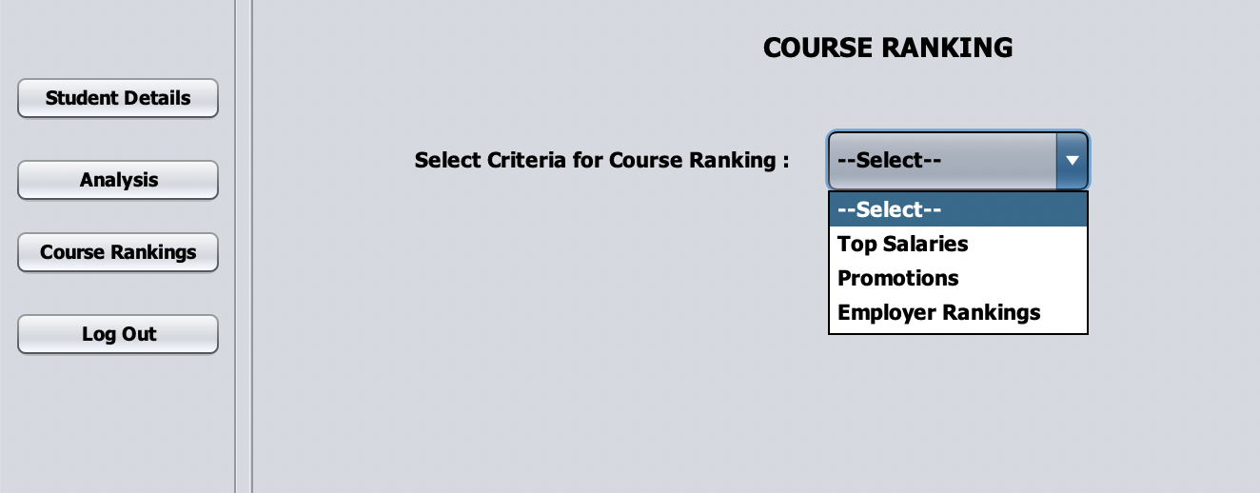
Analysis Dashboard – Course Ranking

Slide 12
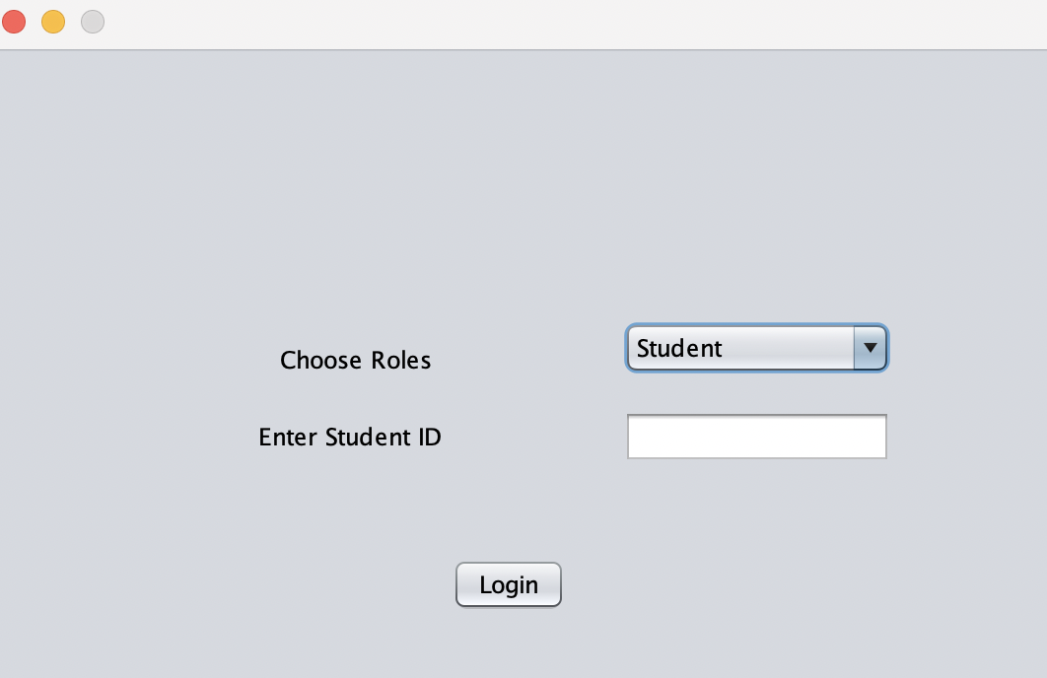
Student Login – Student’s Graduation Information

Slide 13
Student Login – Student’s Graduation Information
Each student, whether alumni or current can login using student ID. Students can view their:
Courses opted
Scores in each course
Total GPA

Slide 14
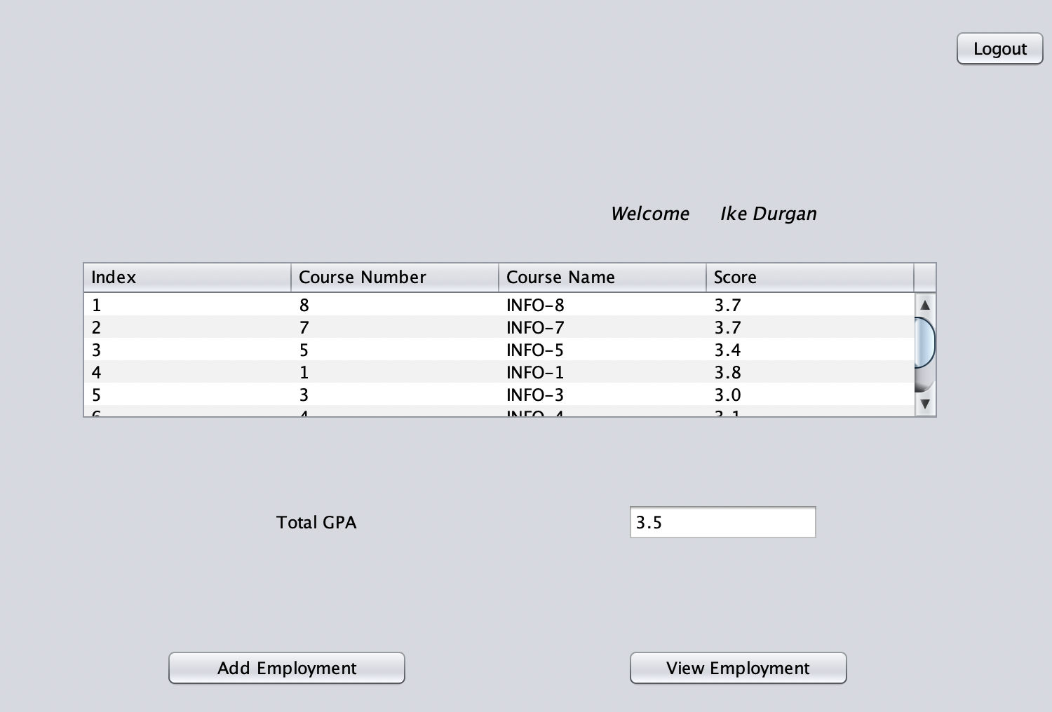
Student Information

Slide 15
Student Login – Student’s Employment Information
Students also have an option to add/view their previous/current employment information. This includes:
Employer information
Designation
Salary information
Employer Ranking
Moreover, students can provide feedback courses by checking the check box. Feedback courses are the courses which students believe helped them frame their career. These are the courses which were opted by student.

Slide 16
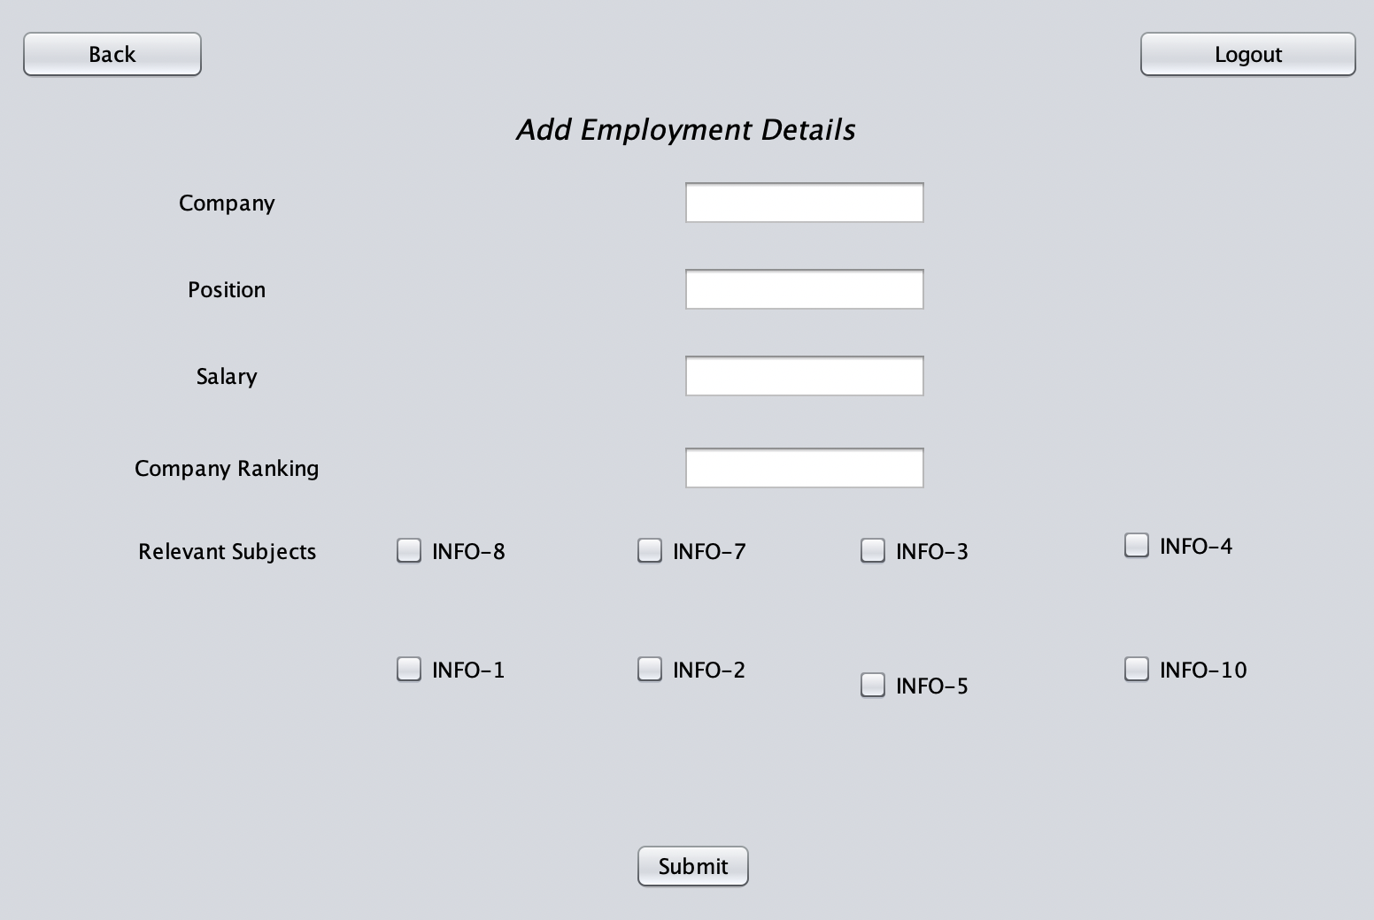
Add Employment Information

Slide 17
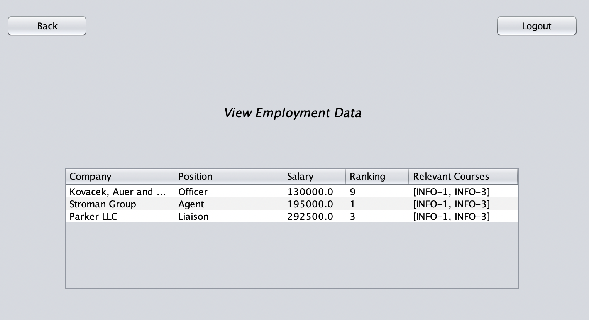
View Employment Information

Slide 18
Object Model Diagram

Slide 19
Sequence Diagram – Admin Login

Slide 20
Sequence Diagram – Student Login

Slide 21
University Brand as Credibility
University plays a very crucial role as an intermediary between students and employers. Both students and employers rely on the credibility of university. And to digitally implement this, we have come up with some ideas :
We can extend our application by integrating a dashboard where employers can post job openings in accordance with course offerings and skill sets. Employers can reach out to students having matching skill sets based on their courses.
Using the same portal students can reach out to the employers and showcase their profile.

Slide 22

Extended Idea
1. Our implementation showcases on department level. We can extend our idea by implementing on college level and then on university level with the similar approach.
2. We can add several other attributes in student account, for ex: facultyFeedback, where students can provide feedback for faculty with similar approach as relevantCourses.

Slide 23
Digital Ideas and Solutions to k-to-12 Educational Systems
Students particularly of junior and senior high find themselves overwhelmed with choosing the right career path. Most of them are oblivious to the current industry trends. Our vision is to provide university’s analysis data to schools which can provide students insights on current market trends and help them decide and explore career of their interests.
Design an application for children under the age of 10, which can analyze the cognitive abilities such as verbal, perceptual performance, general cognitive, memory etc., based on their exam results and determine the strength and weaknesses of students.

Slide 24

Relationship Between GPAs and Industrial Success
As per our analysis there is no relationship between GPA’s and industrial success. There are many students who scored less and are paid higher salaries or have received more promotions than the students who have higher GPAs. We assume there might be several reasons behind such as:
GPA is an average of all the subjects combined altogether. Scoring less in two or three subjects can lower the overall GPA. It might be the student who had less GPA and currently paid higher was good in JAVA (scored high) but scored less in some other subjects which eventually led to lower overall GPA.
External factors such as emergency travels, serious health issues etc. may lead to lower GPAs.

